Slide 1
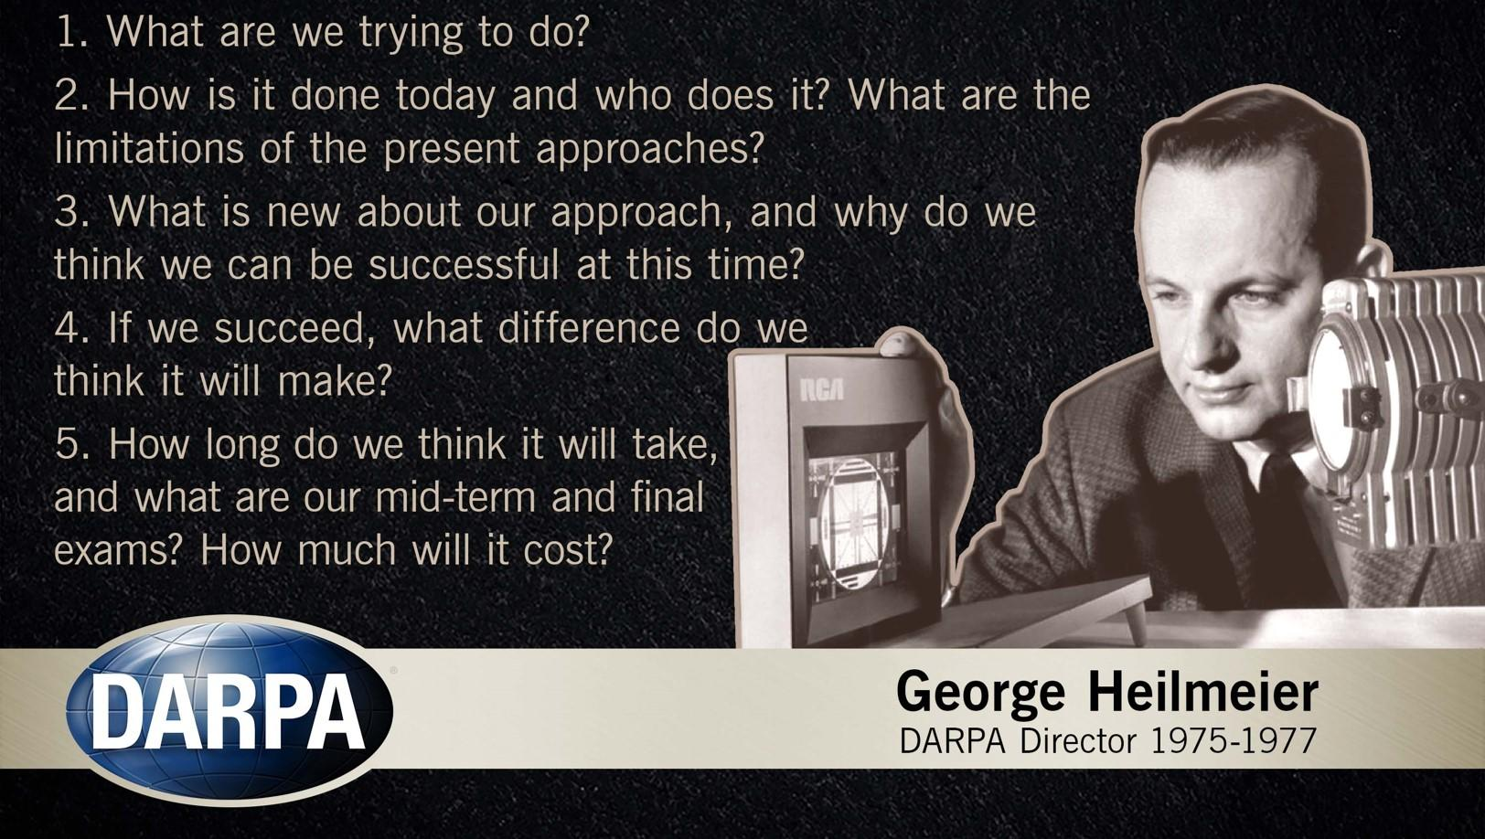
Team B2 – Leonardo Da Pinchy
Bryan Hong, Aaron Tang, Jonathan Waller
`
Add your 10 slides after this slide… [remember, 10 min talk + 3 min Q/A]
For more information about formatting or importing slides see:
https://gsuite.google.com/learning-center/products/slides/get-started/
Make sure to cover
(refer to the Design Presentation Guidance):
Use Case & Requirements - Remind us who is your customer, what product do they want to buy and quantitative reqs [keep it short]
Quantitative Design Reqs - Map quantitative use case to quantitative design requirements
Solution Approach - Remind us of solutionn path(s) … and social, cultural, global .. factors; any changes since proposal ?
Block Diagram - Detailed design: incorporate flow diagrams, state diagrams, protocols
    Implementation Plan - include Design Trade Study(ies) here; what will YOU develop ? vs buy/download/reuse ?
Testing, Verification and Metrics - including quant metrics; how you will test and what is passing; failed tests ? Risk mitigation ?
Project Management - WHO is going to do WHAT and WHEN ?
Consider that this slide already works as a introduction slide so use your first slide wisely
Remember – Relevant figures (and tables) can be worth
“a thousand words”!

Slide 2
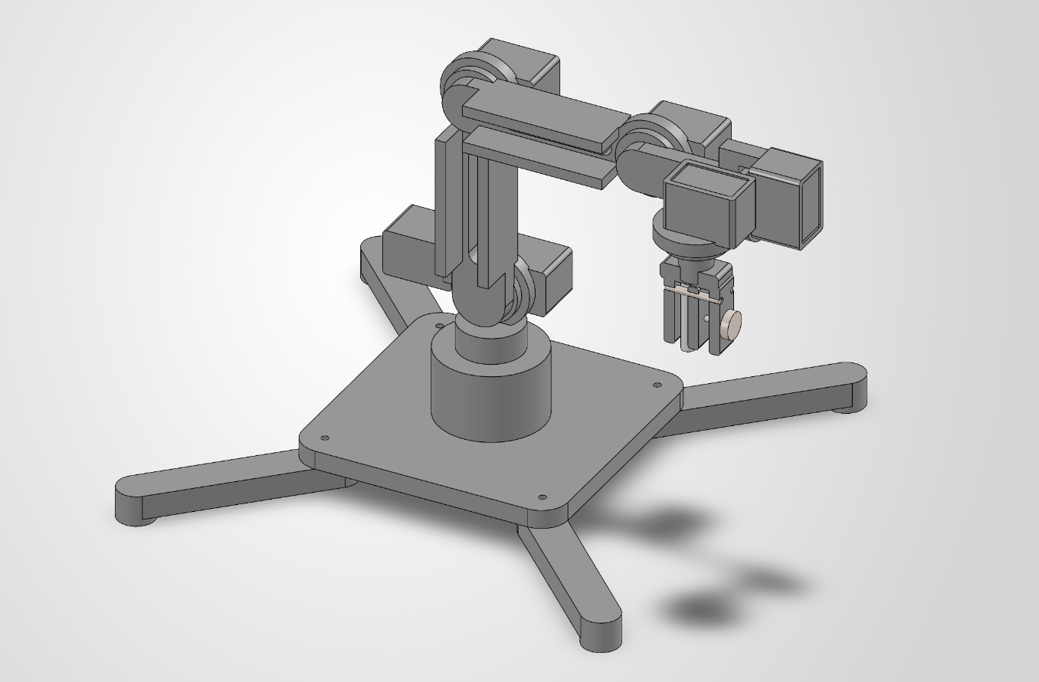
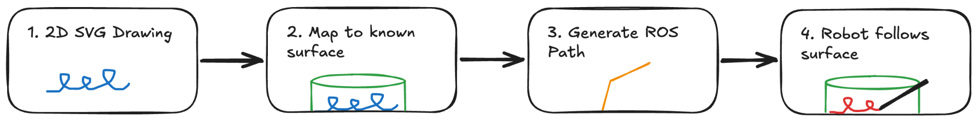
Use Case/Application
Transfer digital artwork onto curved objects
Adapt drawing motion to changing surface orientation
Support low-volume, high-variation custom artwork

Slide 3
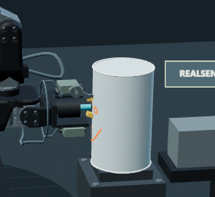
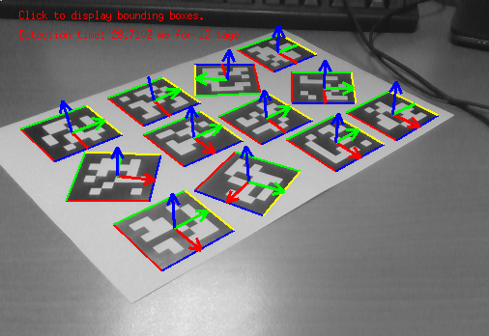
Quantitative Use-Case Requirements
Requirement | Target | Justification
Target specifications | One surface; shape, curves, and dimensions known | Keeps the testing surface bounded.
Working area | 0.4 × 0.4 × 0.4 m | Allow space for the target, holder and pen motion.
Drawing surface alignment | Camera + fixture reference; set distance from target | Place the target consistently in a fixed location in front of the robot.
Surface drawing area | Predefined, with front 180 degrees reachable only | Avoid collisions and unreachable back surfaces.

Slide 4
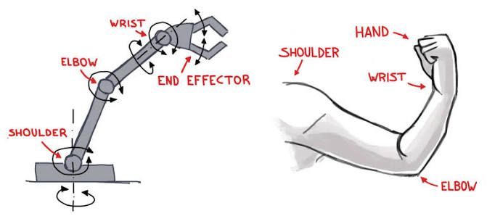
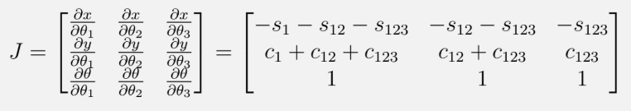
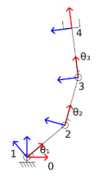
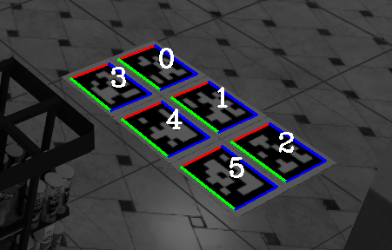
Quantitative Design Requirements
Use-Case Requirements
Target specifications
Working area (0.4m x 0.4m x 0.4m)
Drawing surface alignment
Surface drawing area
Design Requirements
6 Degrees of Freedom (DOF)
Arm Max Reach Radius (≥ 0.50 m)
Camera Pose Error (≤ 2mm)
End-Effector Accuracy (≤ 2mm)

Slide 5
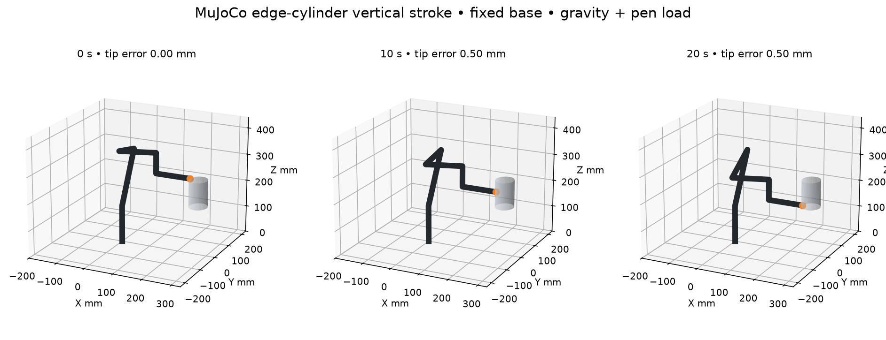
Solution Approach
Design Decision | Requirement | Justification
Use a known non-planar surface | Accurately transfer a 2D path onto a curved object | Provides predictable environment for robot & easier programming
Use a 6-DOF arm | Control pen position + direction over curvature | A 3-DoF system moves XYZ, but can’t orient pen around varying surface orientations
Restrict drawing to the reachable front region | Complete the drawing without unreachable/colliding poses | Keeps the required workspace compatible with arm's reachable poses

Slide 6
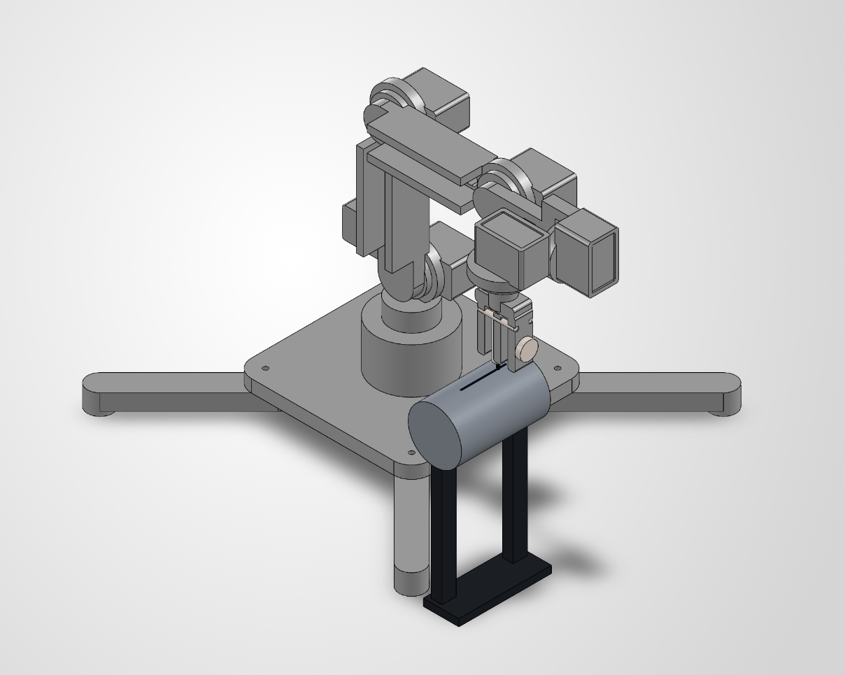
Solution Approach Pt. 2
Design Decision | Requirement | Justification
SVG (Scalable Vector Graphics) input | Accept digital line drawings and convert them into robot trajectories | SVGs are ordered vectors, be easily mapped onto coordinates
Use camera + AprilTags | Align the digital surface model with the physical object | Need repeatable coordinate frames so digital path lines up to physical object
Use a fixed marker rack location | Reliably support multiple colors | Fixed known pickup locations simplify reliable color changes

Slide 7
System Specification
Inputs
Software
Hardware
Output
Robot Arm
Robot Execution
External
Computer
User’s Interface
User Design
Browser UI
Servo Motor Gripper
Smart Serial Bus Servo Motors
Scale and transpose 2d points onto the surface in 3d points
Jetson
Orin
Nano
Surface Dimensions
Power Bank
(12V DC)
UART
PWM
Robot Arm Path Construction
Robot
Control
System
HTTPS
GET/POST
ROS2_control_node:
Motor control algorithms
RVIZ: Robot Simulation and Visualization
Intel RealSense
Depth Camera
USB C
Catmull Rom Splines + Cartesian Path Interpolation
Marker Positions
MoveIt 2: Inverse Kinematics + Motion Planning
Surface AprilTags
Surface Pose

Slide 8
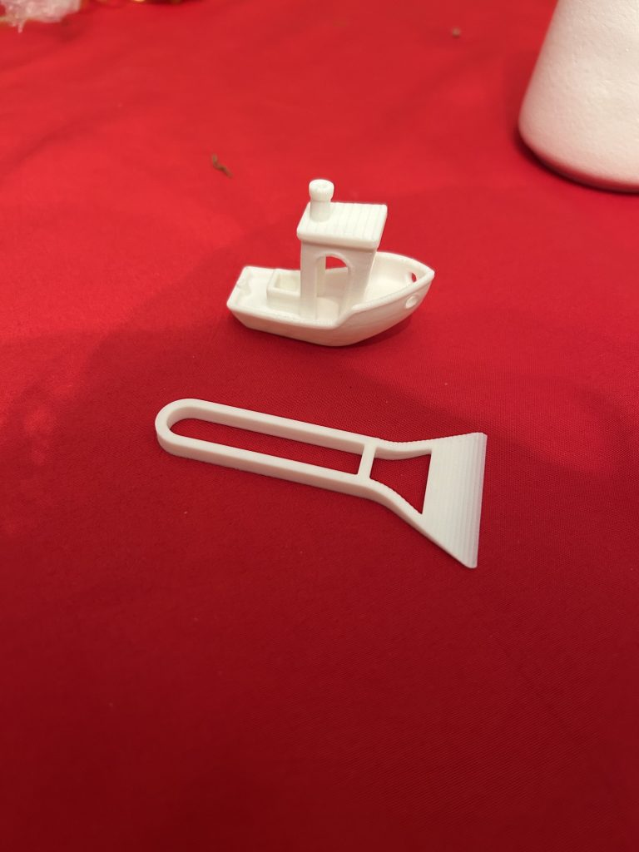
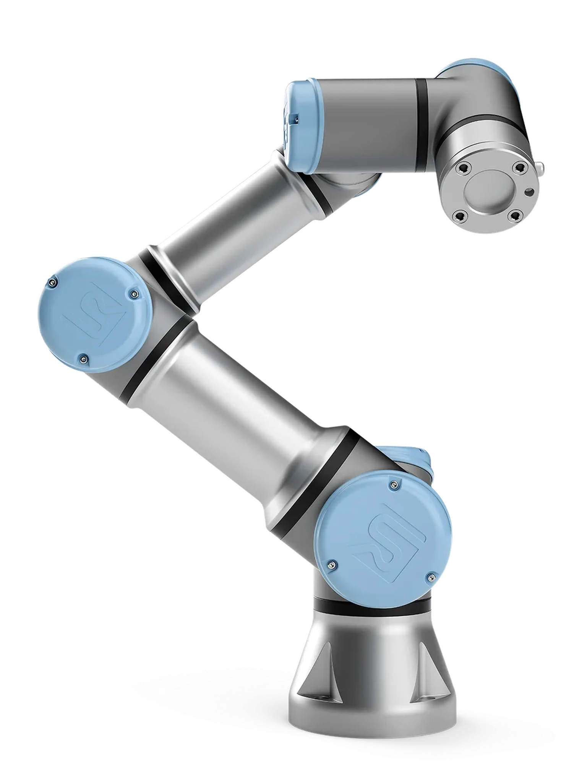
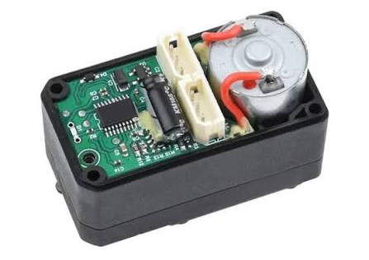
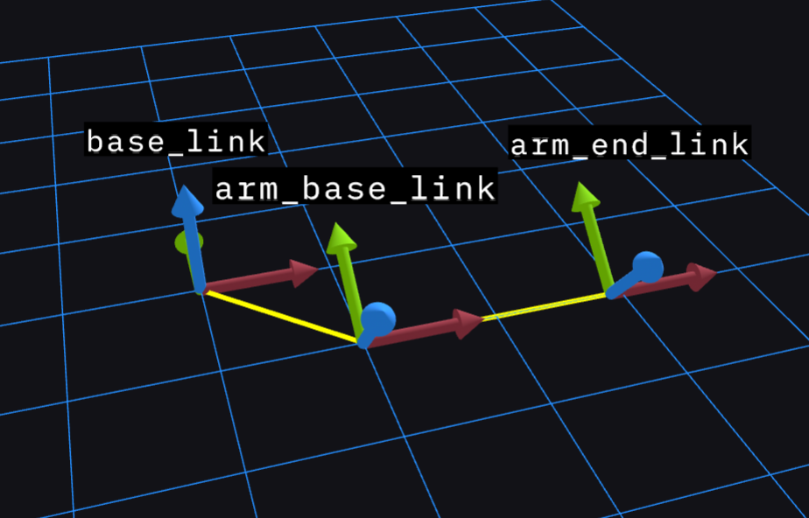
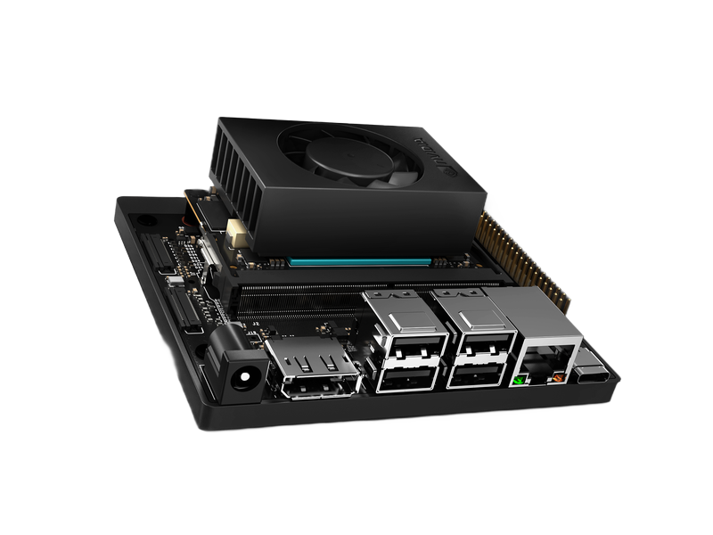

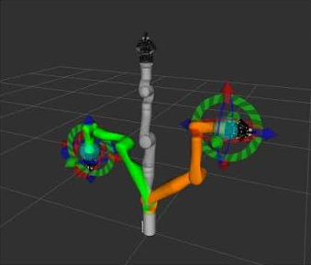
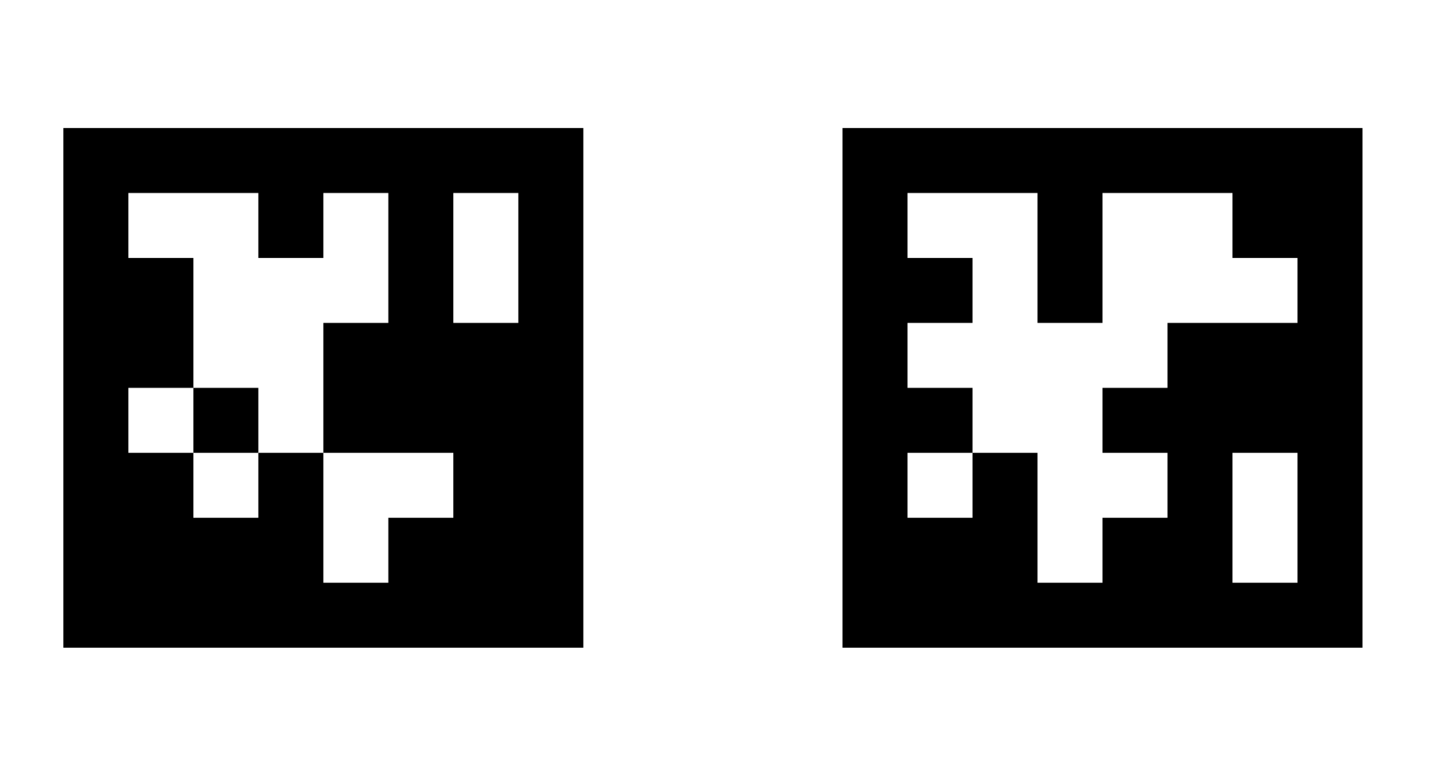
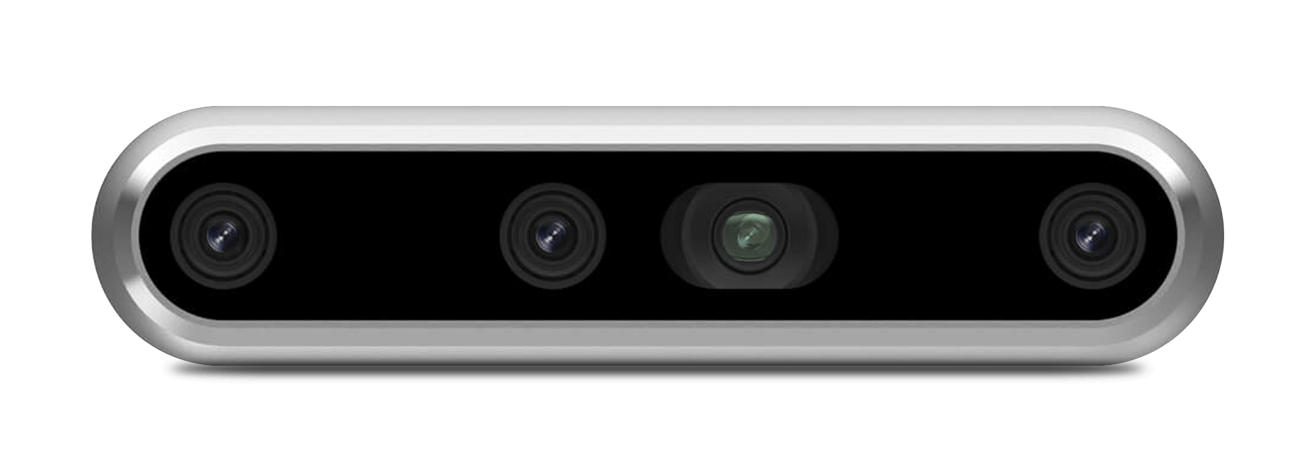
Designing and Assembling:
Designing and 3D Printing
the Full Robot Arm
Custom ROS2
Software Stack
AprilTag Pose
Detection and CV
Implementation Plan
Inspiration and Tools:
URE3 Robot Arm
RVIZ 2 and MoveIt 2
Parts to Buy / Use:
Smart Serial Bus Servo
Jetson Orin Nano
Intel
RealSense
Depth Camera

Slide 9
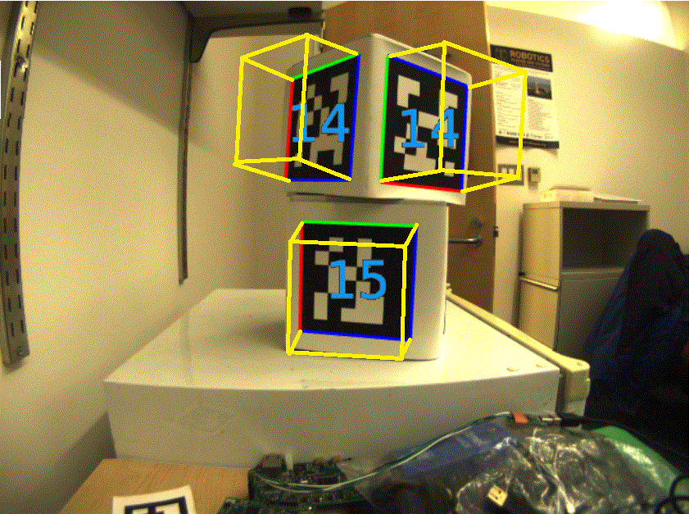
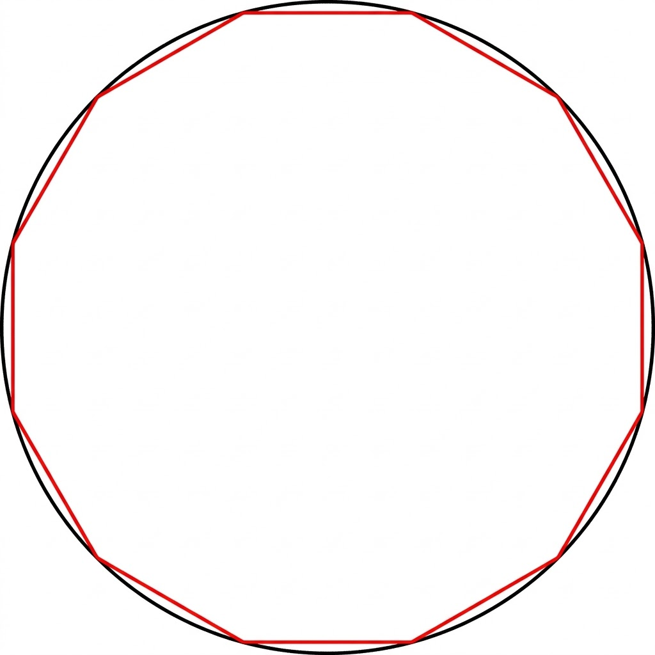
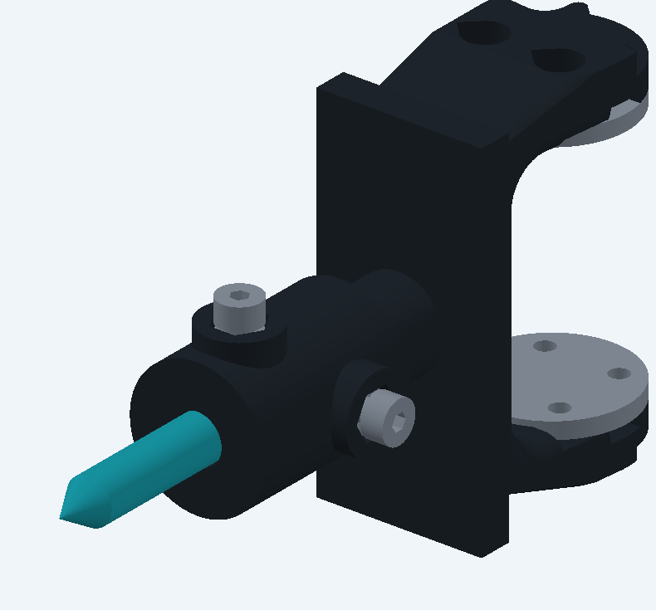
Test, Verification, and Validation
Surface Pose Detection
AprilTags + OpenCV
Absolute error ≤ 2 mm
3D Position Accuracy
Abs. position error ≤ 2 mm
Drawing accuracy: printed vs drawn pattern ≤ 2 mm
Pen Selection & Pickup
Test pen holder reliability
90% pickup accuracy

Slide 10

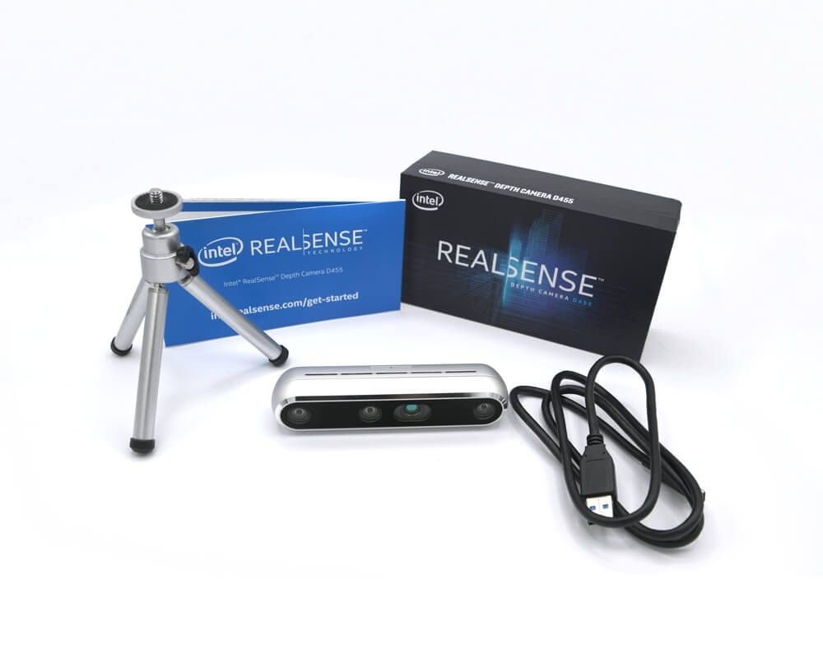
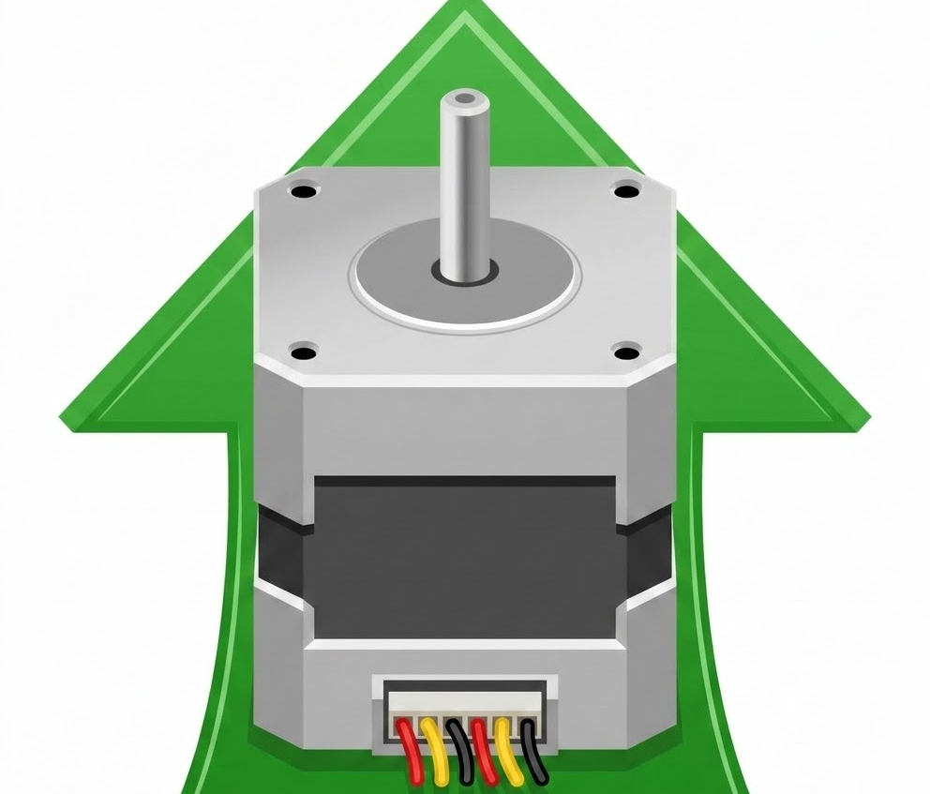
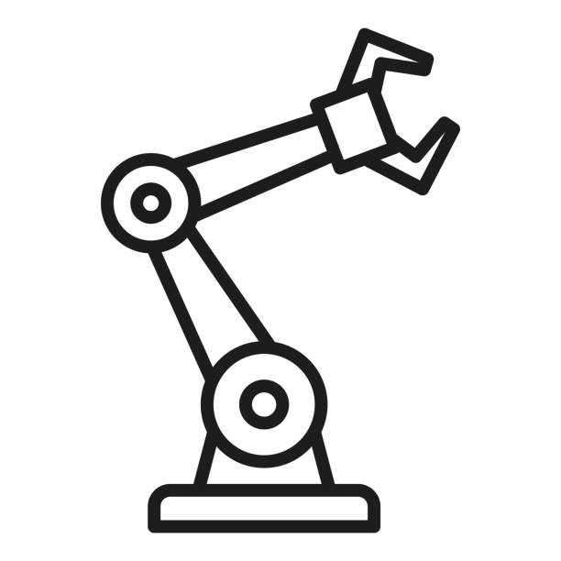
Risks and Unknowns
Surface Pose Detection Failure
Marker Selection & Pickup Failure
3D Position Accuracy Failure
Train YOLOv26 detection model on AprilTags
Use depth functionality on camera for detection
Fix location of object to optimal area on workspace
Upgrade motor strength/control

Slide 11
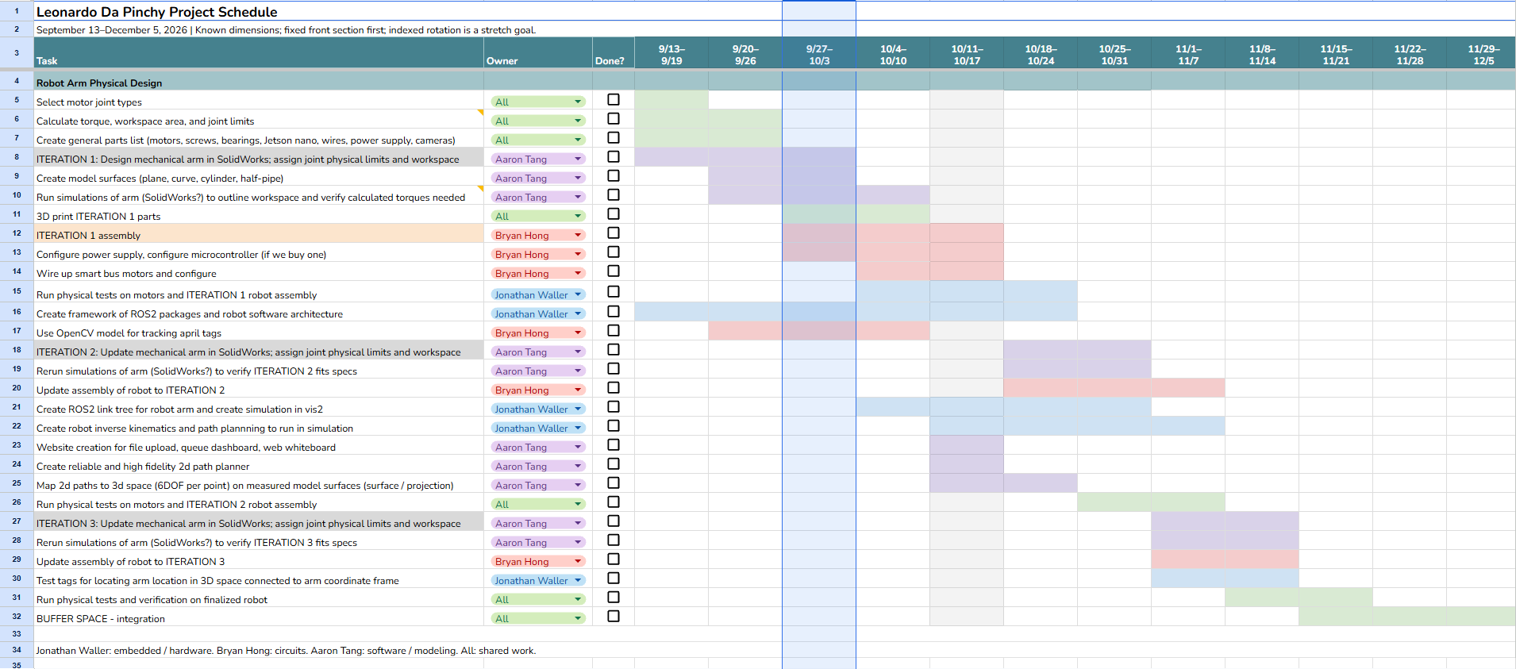
Schedule & Demonstration Milestones

Slide 12
OLD SLIDES BELOW:
Remember – Relevant figures (and tables) can be worth
“a thousand words”!

Slide 13
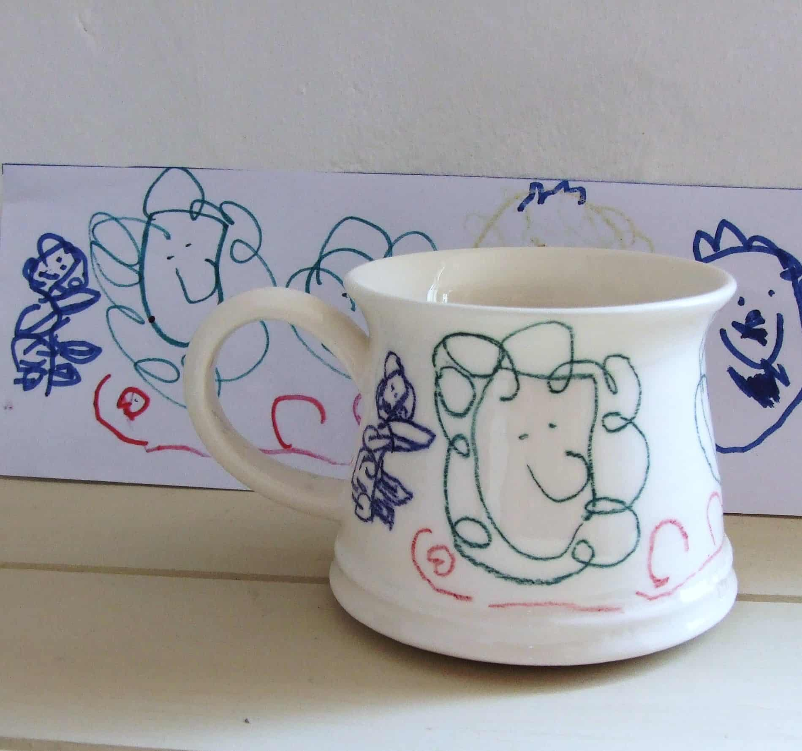
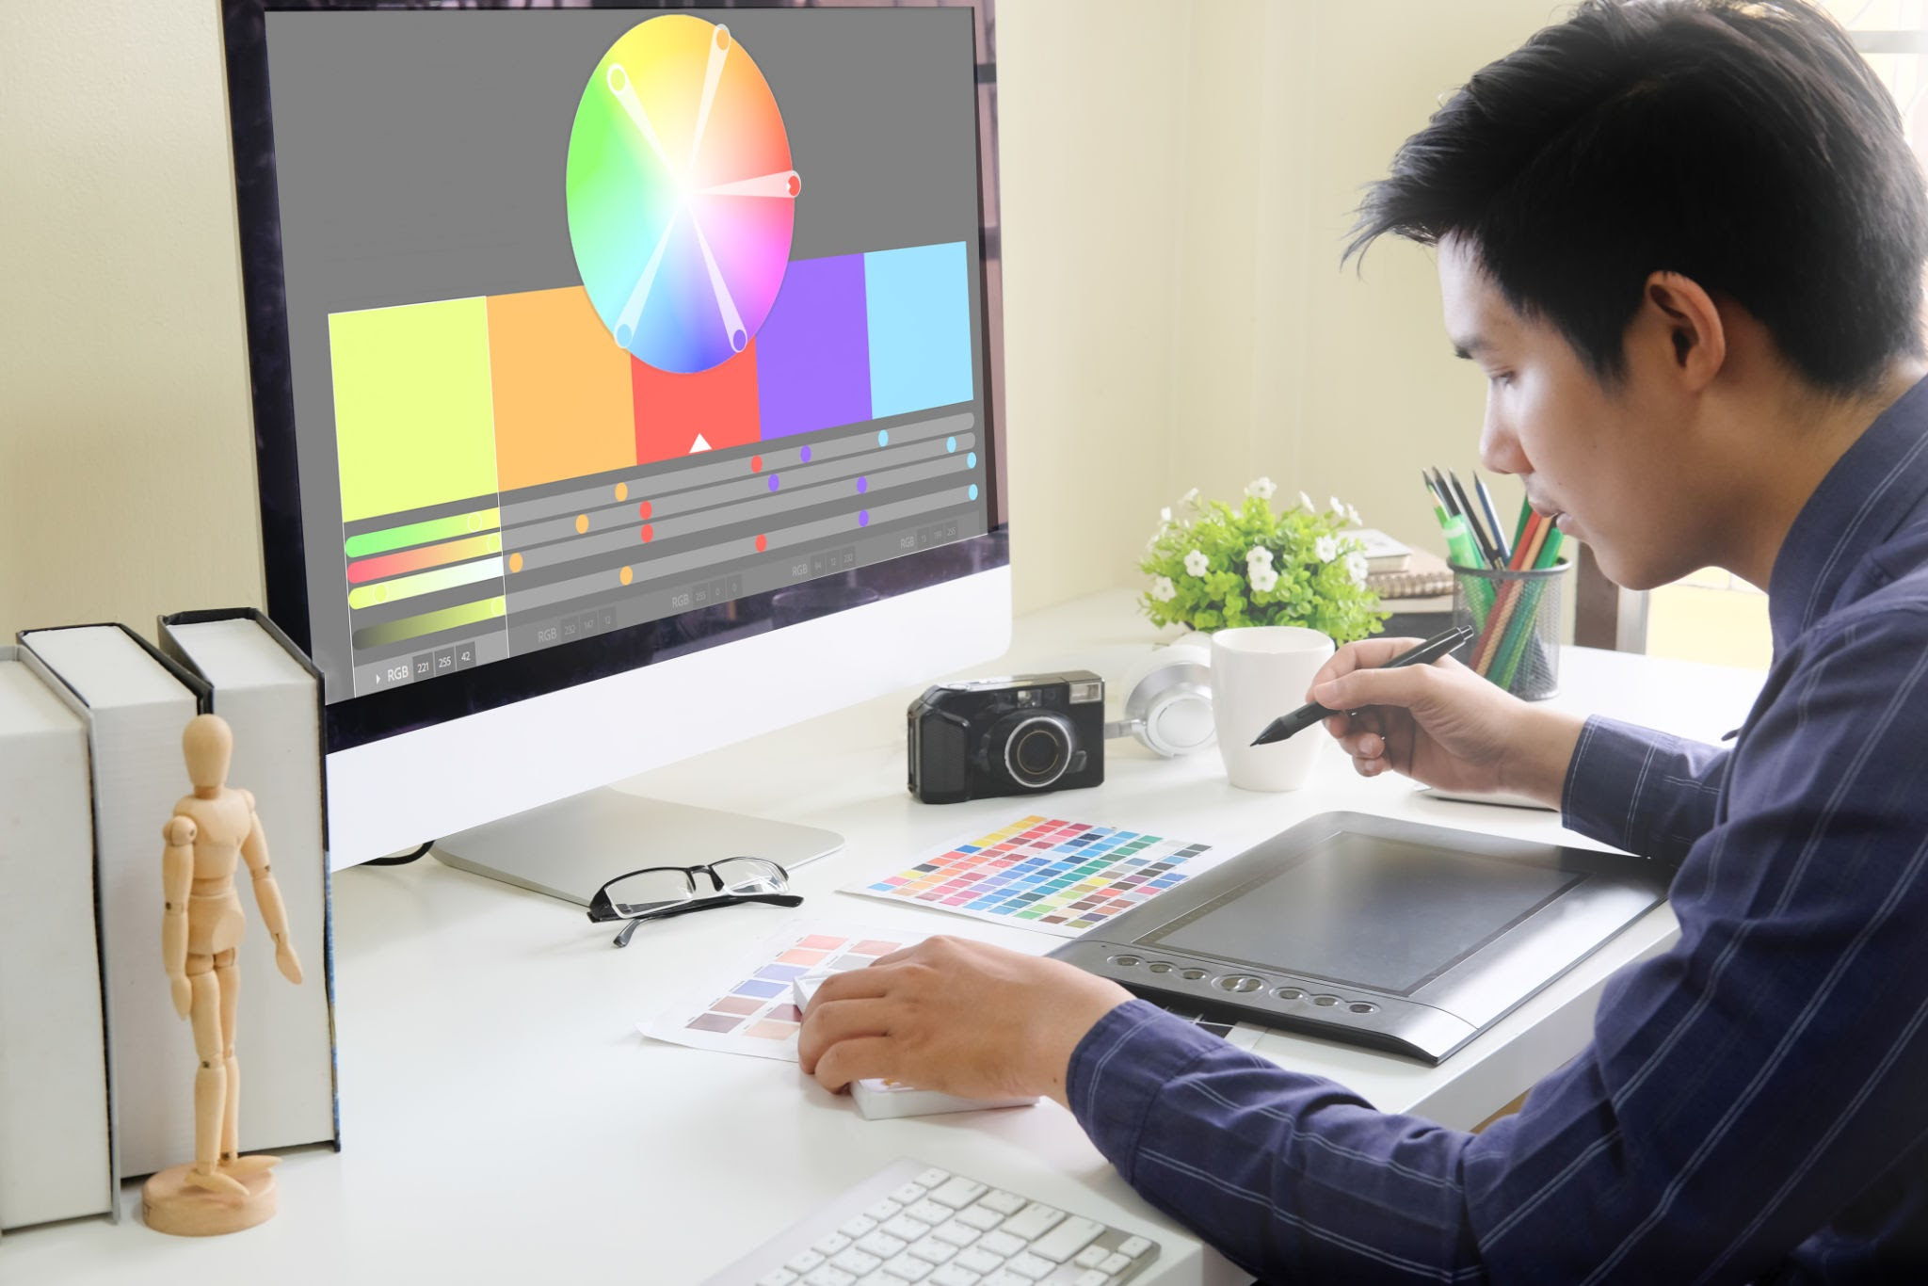
User Story
Digital artist and business owner Leonardo creates custom ceramic mugs
Leonardo makes his designs digitally
Redoing every design on each mug is time consuming at scale
He wants a robotic solution that allows him to produce mugs en masse

Slide 14
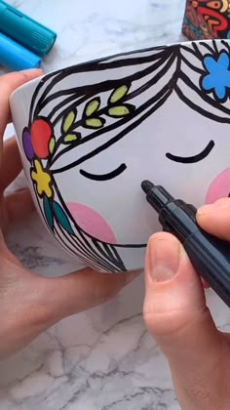
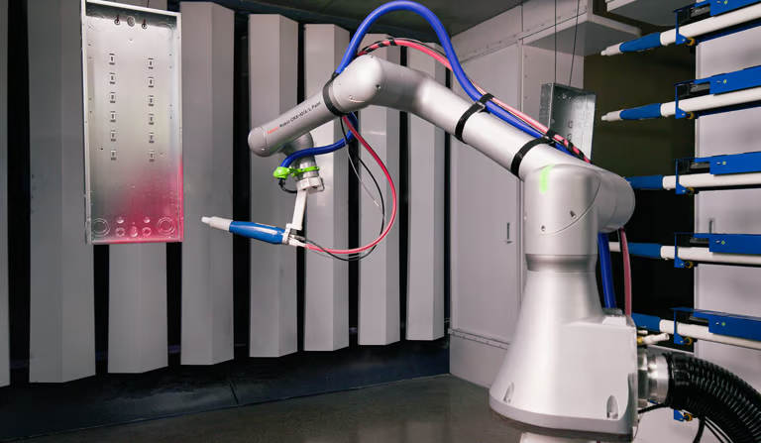
Use Case
Reproducing digital art on non-planar surfaces where using standard CNC machines with 3 DoF is difficult
Often, problems with printing are:
Lack of stroke depth, colors, and fluidness
Robots have a difficult time adjusting to surfaces it’s not familiar with
Our robot should successfully replicate a piece of submitted art on a fixed non-planar surface whose dimensions we know.

Slide 15
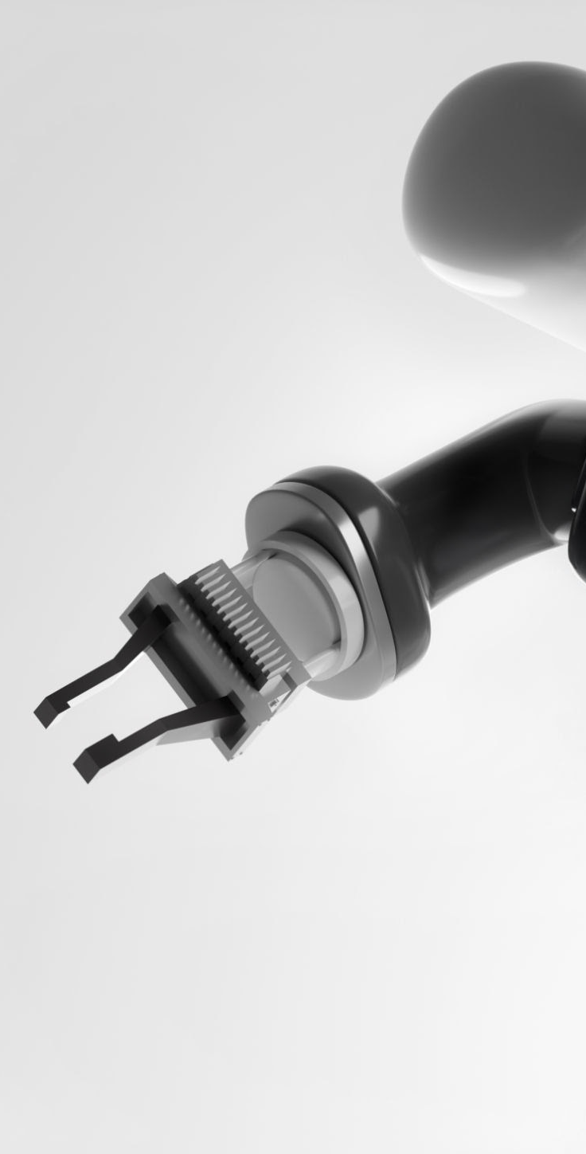
Use-Case Requirements (1/2)
Requirement | Target | Justification
Target specifications | One surface; shape, curves, and dimensions known | Keeps the testing surface bounded.
Drawing area | Predefined, with front section reachable only | Avoid collisions and unreachable back surfaces.
Drawing surface alignment | Camera + fixture reference; set distance from target | Place the target consistently in a fixed location in front of the robot.
Working area | 0.4 × 0.4 × 0.4 m | Allow space for the target, holder and pen motion.

Slide 16
Use-Case Requirements (2/2)
Requirement | Target | Justification
Drawing format | SVG vector paths | Preserve digital strokes for mapping onto the curved surface.
Line accuracy | Target ≤2.00mm surface-path error; statistic TBD | Keep outlines useful for subsequent carving or painting.
Input limits | 2 colors; 50 strokes; 100 cm combined path | Support small patterns while bounding job complexity.
Pen orientation | Proposed 6-DOF arm | Adjust pen position and angle along the known curve.

Slide 17
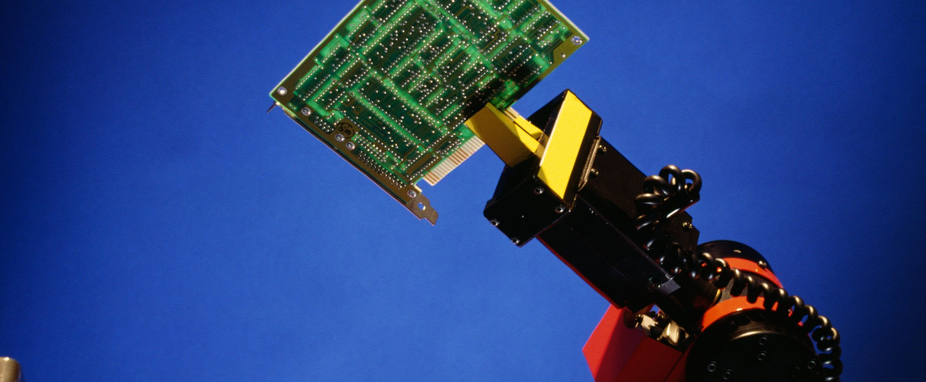
Technical Challenges
Challenge | Requirement | Proposed response
Weight of arm | Arm needs needs to be able to draw without falling over | Install heavy counterweights at the base, or bolt the arm to a rigid fixture
Target position / rotation | Consistent design detection | Fixed location + April tag for manual calibration of (0, 0)
Marker contact | Maintain contact during curved motion | Spring-loaded holder; force sensing
Marker pickup | At least 90% swap success | Fixed rack; gripper; tip calibration
Reach / orientation | Reach / handle clearance | Front arc + collision checks; rotation later
Degrees of Freedom | 6-DOF | Calculate curved path; adjust pen angle

Slide 18
Proposed Solution
External
Computer
Jetson
Nano
User’s Interface
External Cameras
User Image
Browser UI
Robot Arm
Robot execution
Robot Arm Path Construction
Servo motor gripper
Stepper motor joints
Surface position
and dimensions
Scale and transpose 2d points onto the surface in 3d points
Marker positions
Power Bank
Microcontroller
Inverse kinematics + Cartesian Path Interpolation
(Create the current drawings full path)
Motor control
firmware
Inputs
ROS2 Path Execution
Software
Hardware
Output

Slide 19

1
2
3
4
Object/Surface Calibration
Marker ID and Selection
Coordinate Algorithm Testing
Pen Orientation
Testing and Verification
Procedure: Use AprilTags (QR codes) and external camera for calibration
Metrics:
Calculate error (cm) between calculated origin and intended origin
Ideal error ≤ 2 mm
Procedure:
Use external camera + CV model to pick out desired marker color
Metrics:
Calculate accuracy of selecting correct color marker
Ideal accuracy ≥ 90%
Procedure:
Have robot draw over predetermined printed image
Metrics:
Calculate maximum error (mm) between printed and drawn image
Ideal error ≤ 2 mm
Procedure:
Test roll, pitch, and yaw DOFs while drawing on flat surface
Metrics:
Calculate maximum roll, pitch, and yaw angles
Ideal yaw ≅ 60°
Ideal pitch ≅ 60°
Ideal roll = 360°

Slide 20
Tasks & Division of Labor
Owner | Workstream | Deliverables
Jonathan Waller | Embedded / hardware | Arm, mug holder, gripper, controls; rotary stage later
Bryan Hong | Circuits | Power, drivers, sensor circuits, hardwired stop
Aaron Tang | Software / modeling | Mug alignment, curved SVG paths, kinematics, web UI
All three | Integration / tests | Mug drawing, placement and contact tests

Slide 21
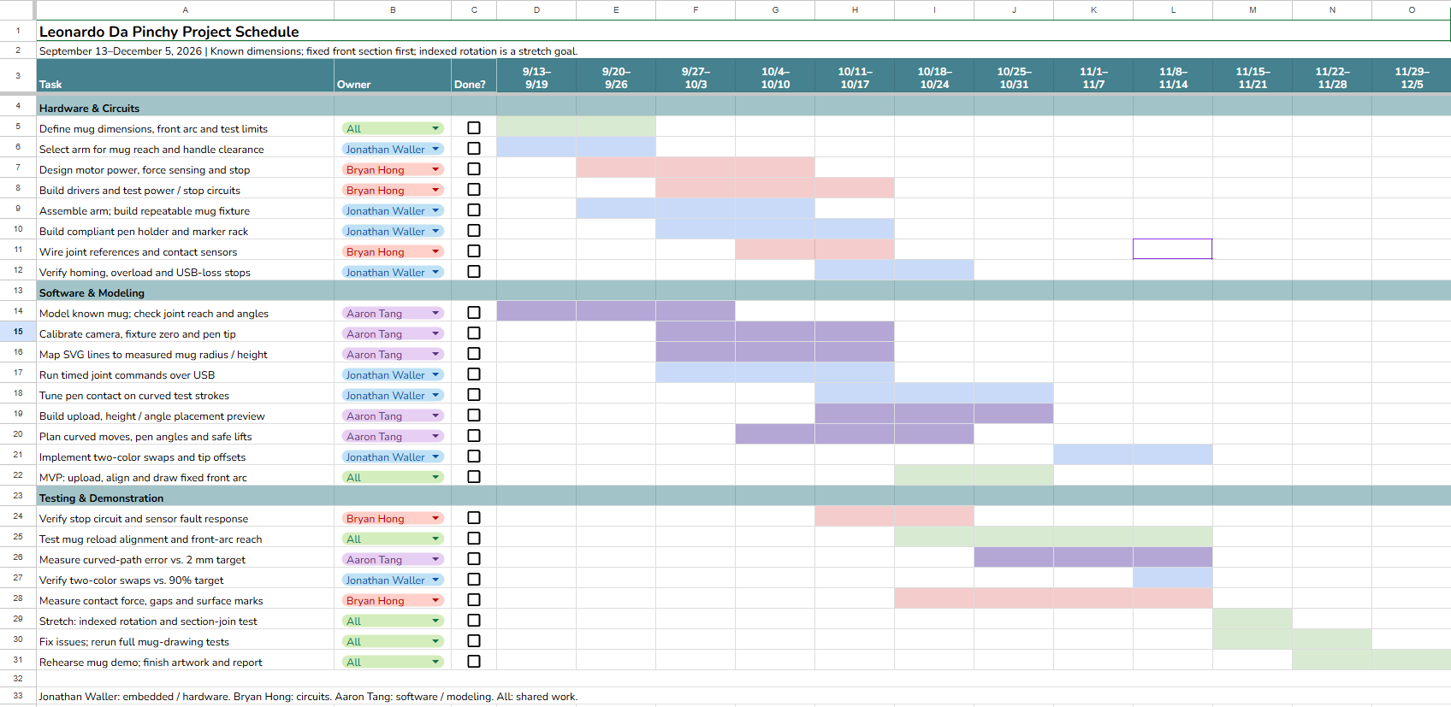
Schedule & Demonstration Milestones

